Slide 1


JuggerNaut Studios
Corporate Overview

Slide 2
Table of Contents
Profile
Services
Technology and Expertise
Case Studies
Why JnS?
Contact US

Slide 3
Profile
About Us:
Launched in 2012
FTE: Over 10+ Full-Time Development Professionals
Creative technologists in
Apps
Games
Cross-Platform, Technology-Agnostic
Where We Are:
Development Center in Pune, India
Working Model:
Project-Basis / T&M / Dedicated
Off-Shore Development Team
BOT

Slide 4
Services
Application Development
Art and Design
Design
Design Direction
Requirement Analysis
Information Architecture
Development
Architecture
Programming
Testing
Deployment
Hosting and Configuration
Performance and Security configuration
Change Management
Production Backup System
Visual Design
Concept Art
Storyboard
User Interface Design
Animation
Game Art
Production Art
Flash

Slide 5
Technology & Expertise
Technology focus
Expertise
Mobile:
iOS
Android
Social:
Facebook
Yahoo
Online:
Flash
HTML5
Java
PHP
Games development
Development
Re-skin
Flash to HTML5
Application development
Web Services
Art and Design
Multi-platform development
Testing / QA
Deployment

Slide 6
Case Studies

Slide 7

Cross-platform game
Built on our own
JnS Game Engine!
Play Now @ http://bit.ly/15reYmh

Slide 8

Wrestling game
Built on ImpactJS!
Play Now @ http://bit.ly/T5rspT

Slide 9

Multi-player betting game
Engaging multiplayer betting game for 2-6 players.
Build on Adobe Flash!
Play Now @ http://bit.ly/15reYmh

Slide 10

Save the Jack!
Built in JavaScript
Coming Soon !!!

Slide 11
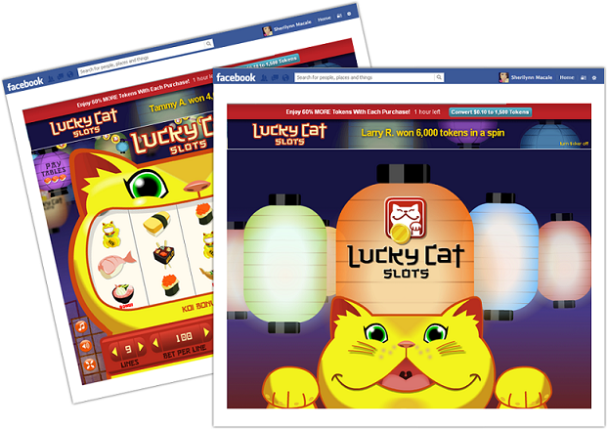
Lucky Cat
Built in Adobe Flash
Play Now @ http://bit.ly/1fmQkJg

Slide 12

iOS Native app
Built for iPhone
Try Now @ …

Slide 13
Contact Us
We look forward to hear from you!
Reach out to us at: contact@juggernaut-studios.com

Slide 14
Thank You

